Slide 1
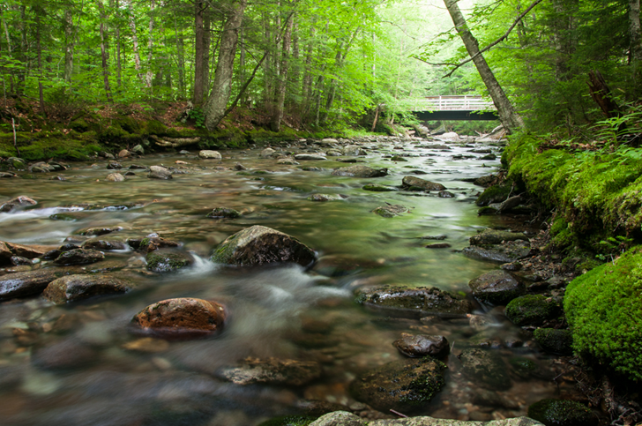
Monitoring Vermont Reference Streams For Climate Change Impacts
Aaron Moore
Vermont Agricultural and Environmental Laboratory
Vermont Agency of Agriculture, Food and Markets
In collaboration with the Vermont DEC Biomonitoring Program
Notes:
- Intro

Slide 2
How climate change affects stream ecosystems
Watershed activities
CLIMATE CHANGE
PRECIPITATION
AIR TEMPERATURE
Riparian
habitat
Water Chemistry
WATER TEMPERATURE
Instream habitat
HYDROLOGY
Fish
MACROINVERTEBRATES
Algae/ Diatoms
Riparian detritus
Notes:
Streams are complex ecosystems:
Integrate stressors at multiple spatial scales
Intricate interactions between biological communities and their habitats

Slide 3
How climate change affects stream ecosystems
CLIMATE CHANGE
PRECIPITATION
AIR TEMPERATURE
HYDROLOGY
WATER TEMPERATURE
MACROINVERTEBRATES
How do changes in hydrology and temperature impact macroinvertebrate communities?
How can Vermont separate climate change and local/watershed stressors when assessing stream health?
Notes:
For this talk, looking to simplify the system; focusing on two of the pathways by which CC affects streams:
Changes in hydrological variability resulting from changes in precipitation
Increases in stream temperature caused by increases in air temperature
Monitoring to answer two questions;
How do these factors impact macroinvertebrate communities
State has been monitoring these communities to assess stream health for decades
Comprised largely of insects, which research suggests are going to be a group affected by CC
How does this affect the ability to assess stream health
How do we separate the affects of climate change from impacts happening at a local/watershed scale?

Slide 4
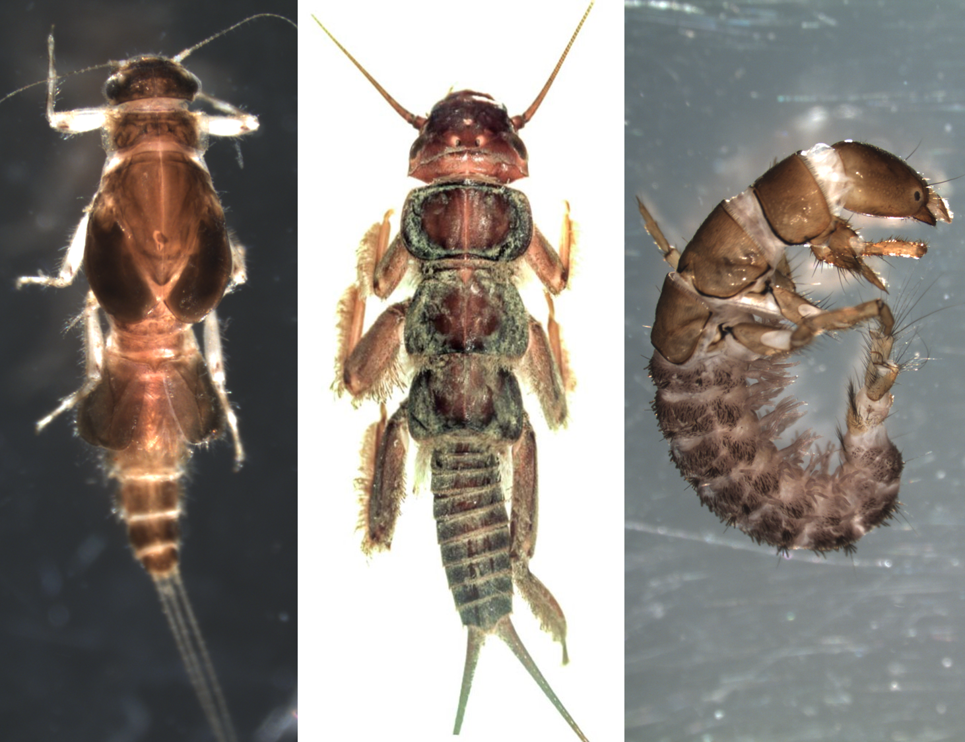
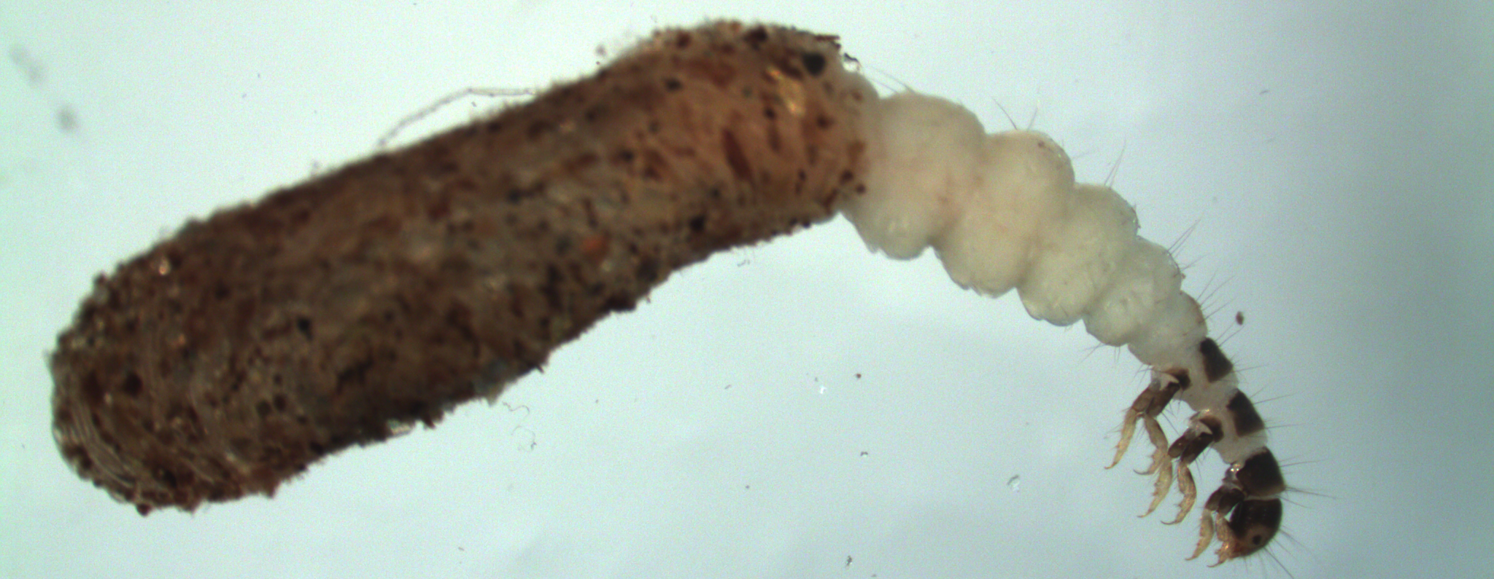
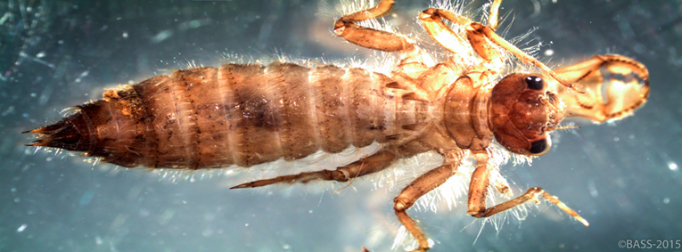
How Vermont uses macroinvertebrates to assess stream health
Notes:
Background on how VT uses macroinvertebrates to assess stream health
Macroinvertebrate communities are primarily insect larvae, collected from riffles in wadeable streams (pictured at bottom)
ID’ed in lab; 8 community metrics scored from raw data (different aspects of structure and function)
Thresholds in each metric determine assessment rating for stream health
Range from Poor>Excellent
Good is minimum for healthy stream
VG and above is at/near reference condition
Ranch Brook in Stowe; over this 10 yr period, at least VG every year.

Slide 5
How Vermont uses macroinvertebrates to assess stream health
Notes:
Contrast this with WBLR; also in Stowe but affected by stormwater issues
Most years doesn’t meet some thresholds, generally fails to meet criteria for healthy stream
Note there are four metrics that will be frequently discussed during talk
Density - #/m2
Total Richness - # unique taxa in sample
EPT Richness - # taxa from mayfly/stonefly/caddisfly – sensitive taxa
Biotic Index – Measure of overall community tolerance to pollution/disturbance (higher # = more tolerant)

Slide 6
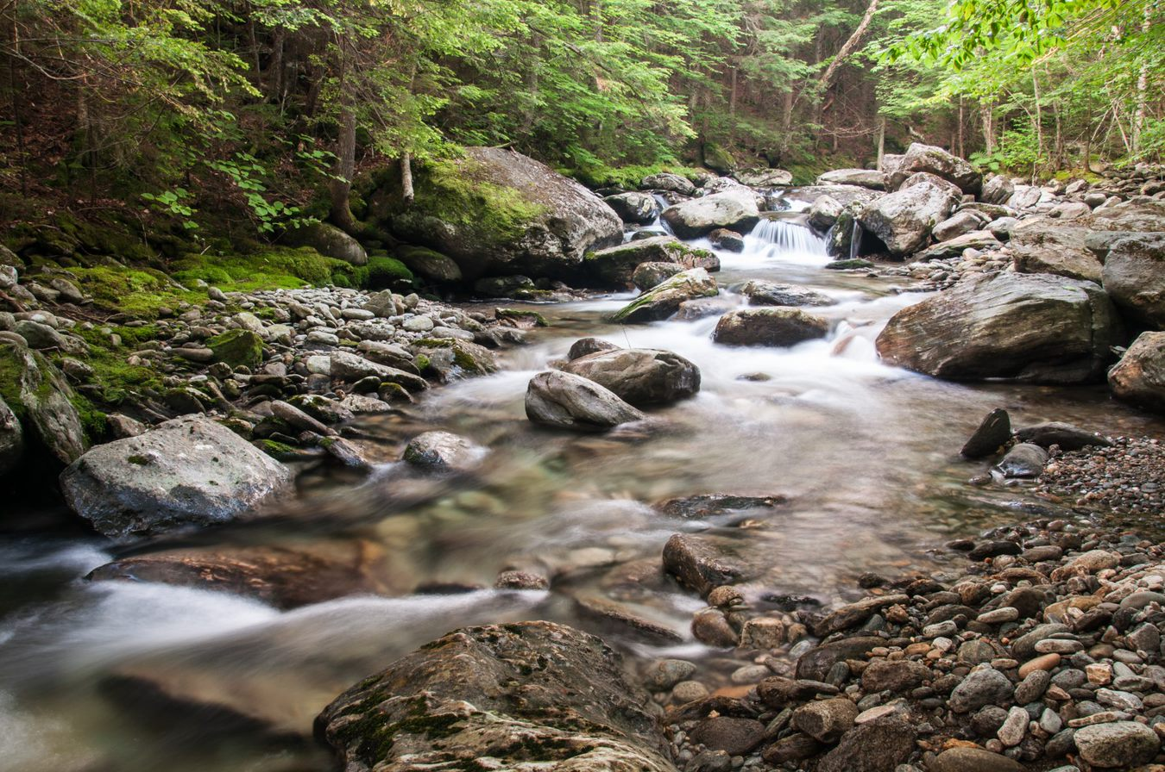
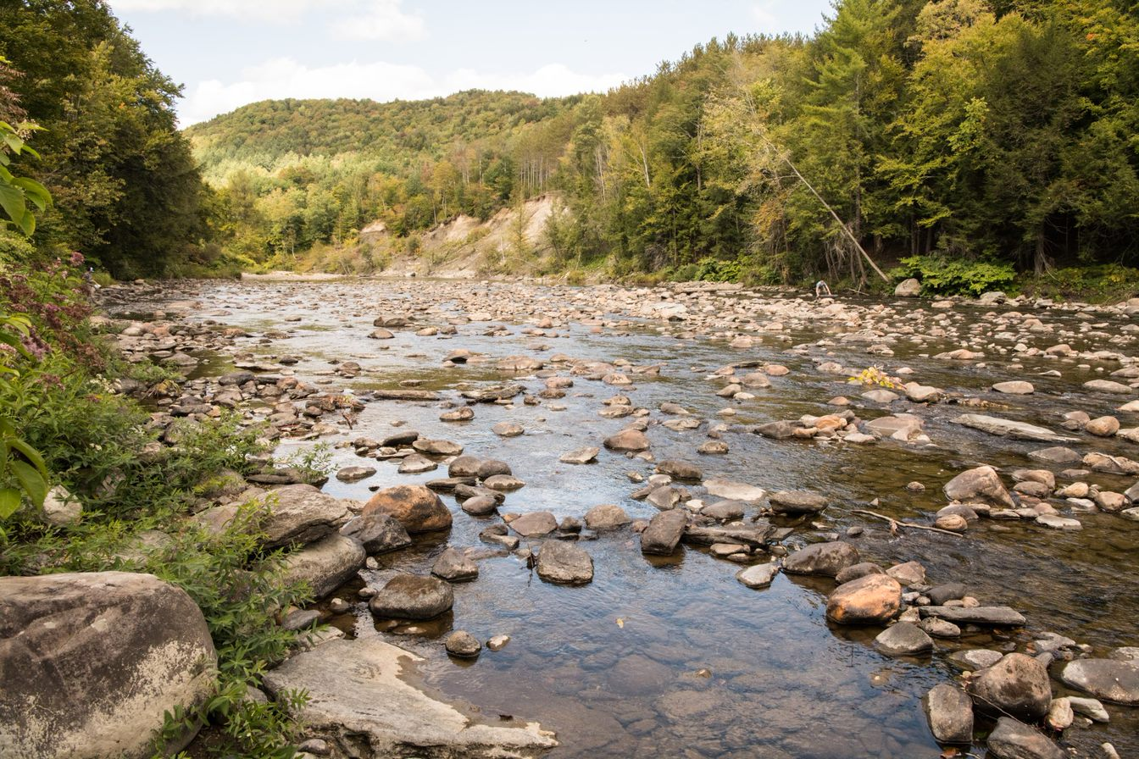
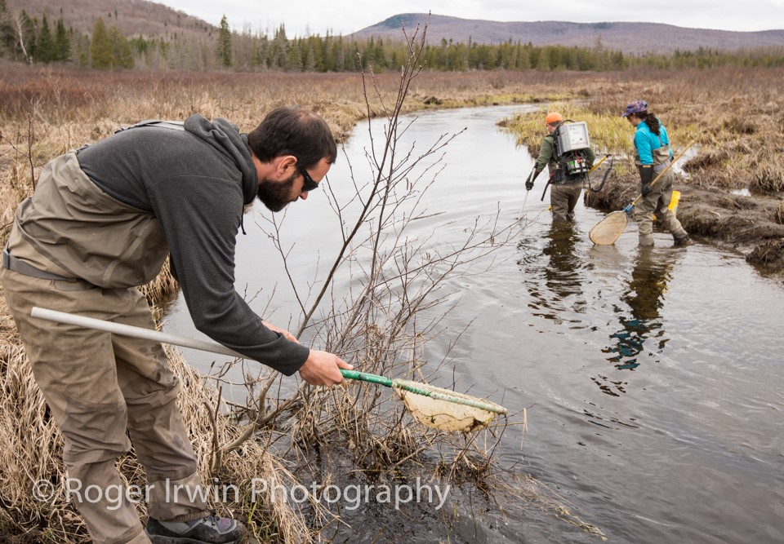
How Vermont uses macroinvertebrates to assess stream health
Small High Gradient
(SHG)
ELEVATION
DRAINAGE AREA
Medium High Gradient
(MHG)
0
Warm Water Moderate Gradient (WWMG)
OPEN CANOPY
DECREASED GRADIENT
0
Hybrid Low Gradient (HLG)
Slow Low Gradient (SLG)
Notes:
State recognizes 5 different stream types
Different thresholds in metrics for each stream type
Focusing primarily on hard bottomed streams (GREEN) which fall along a range of area, elevation

Slide 7
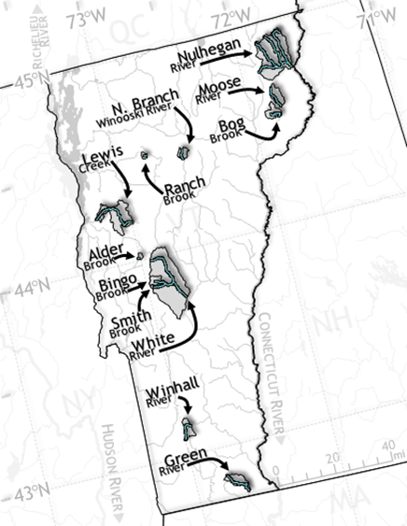
Vermont’s long-term reference stream network
12 “sentinel” streams
  All 5 stream types
  6 are part of EPA’s regional monitoring network
Notes:
VT’s biomonitoring program samples ~130 sites/year for a variety of reasons Within this,12 sentinel streams are more intensively sampled every year
Wide geographical separation
All 5 stream types – broad range of sizes and elevations
Predominantly forested watersheds; most with significant protections against widespread development
6 (BOLD) are part of EPA’s regional monitoring network, joining reference sites across eastern USA with similar monitoring goals

Slide 8
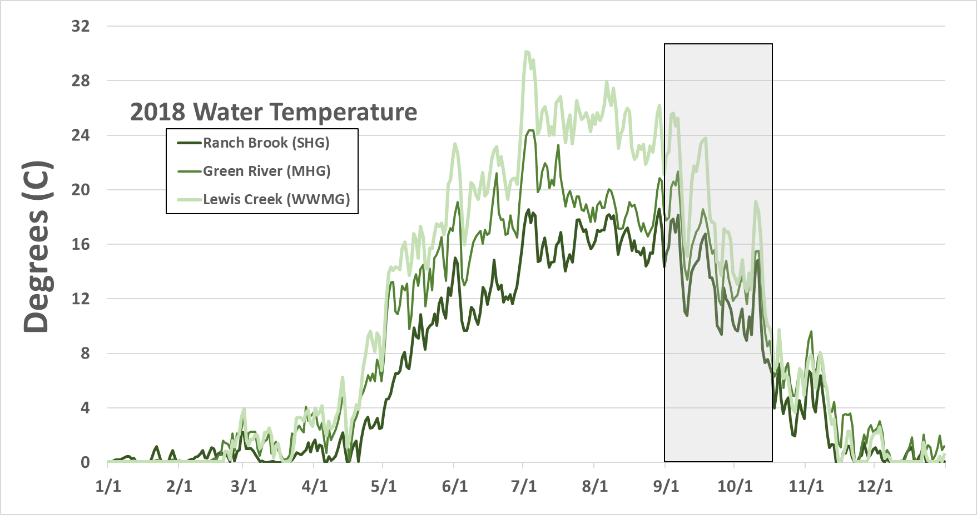
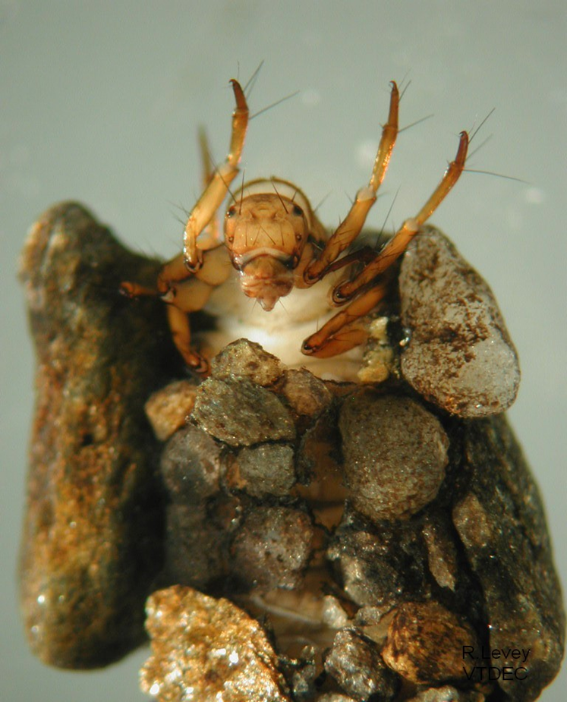
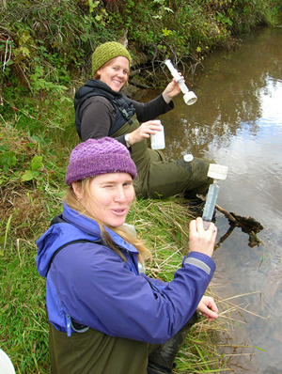
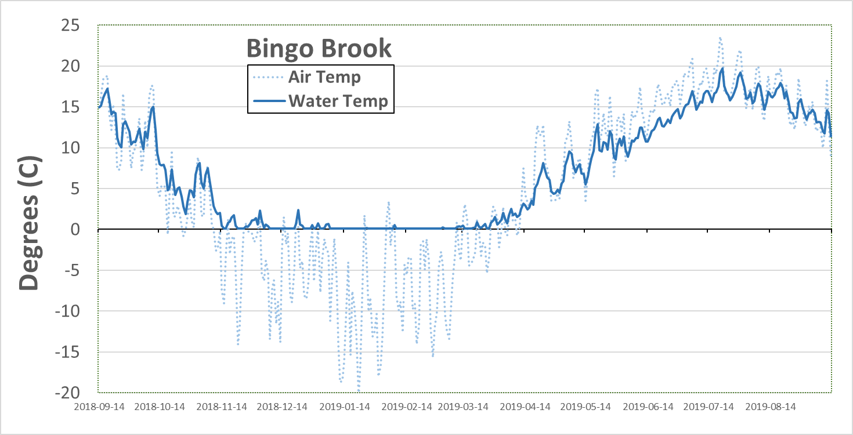
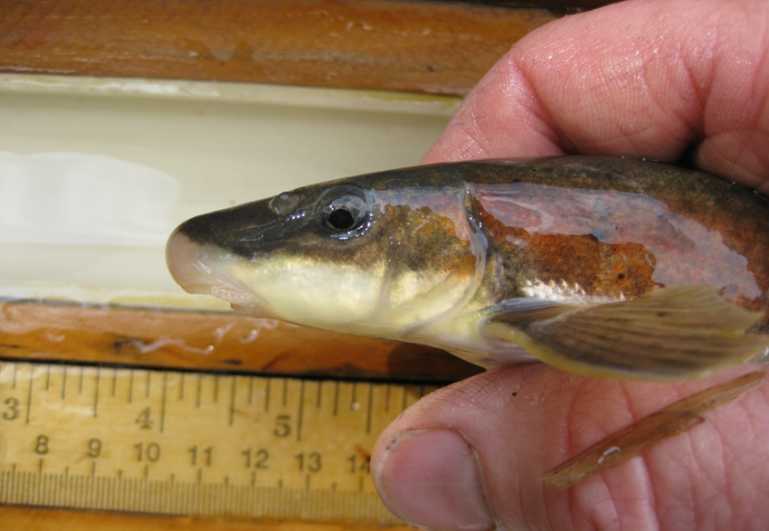
Vermont’s long-term reference stream network
Primary indicators
  Macroinvertebrates
  Water temperature
  Stream Flow
Supplemental monitoring
  Water chemistry
  Air temperature
  Fish community
  Instream habitat
Notes:
At these sites;
Macroinvertebrates sampled annually during Sept-Oct index period
Continuous water temperature
Stream flow gaging at a about half of sites (some overlap with USGS, some gaged by VDEC)
Other important parameters being monitored in conjunction
Examples of:
Water temp across 3 stream types over 2018 calendar year
Larger, moderate gradient streams are warmer throughout year
Note grey box indicates fall index period (will see this throughout talk)

Slide 9
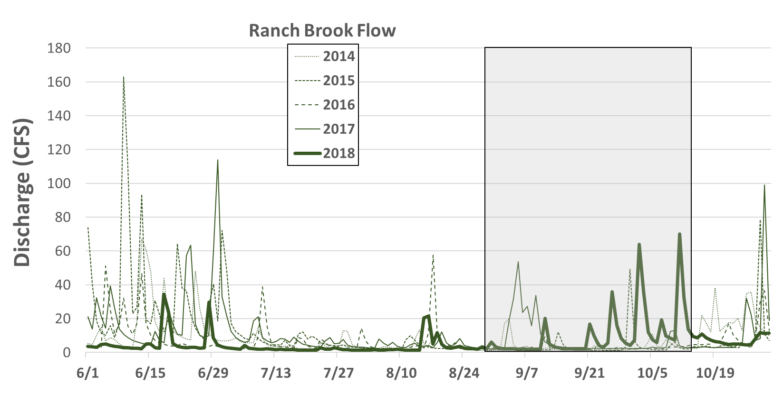
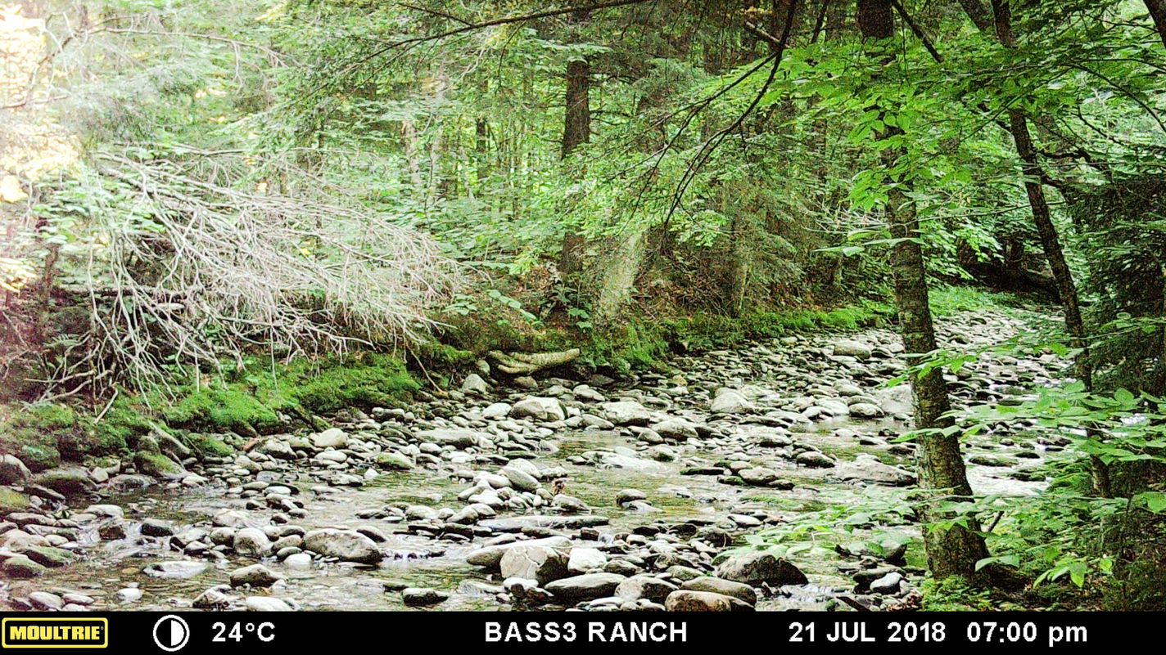
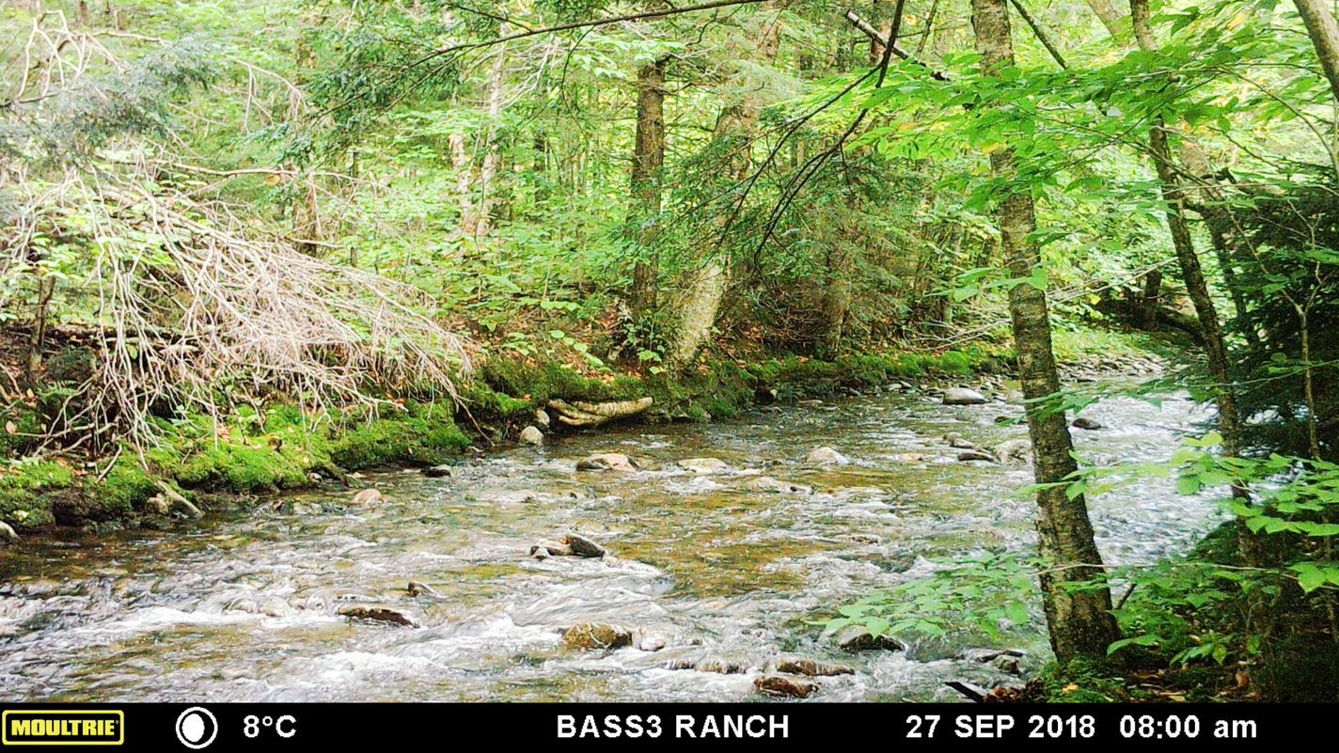
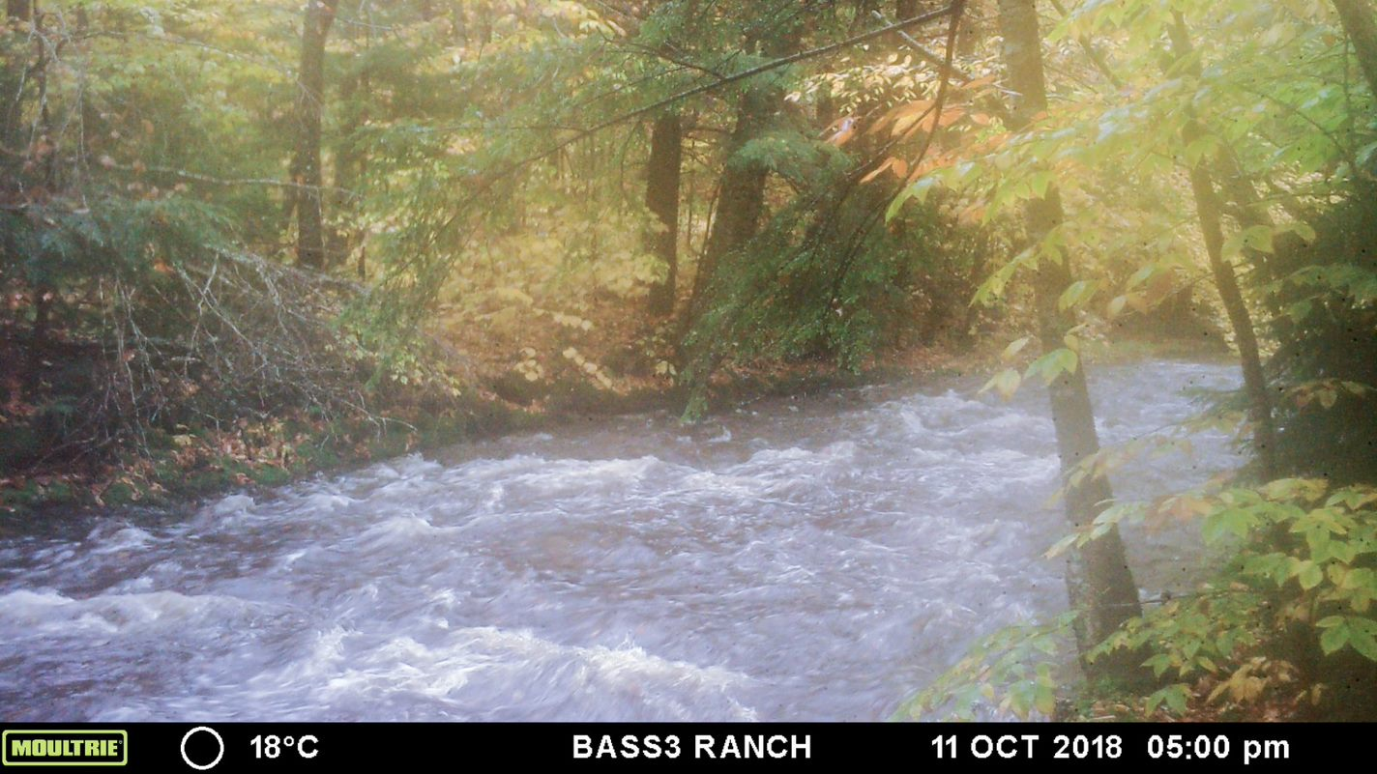
Vermont’s long-term reference stream network
Primary indicators
  Macroinvertebrates
  Water temperature
  Stream flow
Supplemental monitoring
  Water chemistry
  Air temperature
  Fish community
  Instream habitat
Notes:
Example of flow monitoring at Ranch Brook (USGS)
5 years of overlapping data, dark line indicating most recent
Several sites have game cameras to visually monitor flow at invertebrate sampling riffles, see if there’s bed movement

Slide 10
Vermont’s long-term reference stream network
Most sentinel streams currently have:
  7-20 years of annual macroinvertebrate data
  7-12 years water temperature
  0-30 years stream flow data
Future analyses will require much longer periods of record, but there are interesting preliminary results:
  Stream Flow
    Impacts from Tropical Storm Irene
  Water Temperature
    2019 Seasonal study
  Cotton Brook Landslide
Notes:
Understanding the long-term effects of CC on these sites will require a substantial data set
Intensive monitoring of these sites still fairly new, many have paired data for than a decade
However, some preliminary results already helping shed light on community impacts, and how assessments are affected

Slide 11
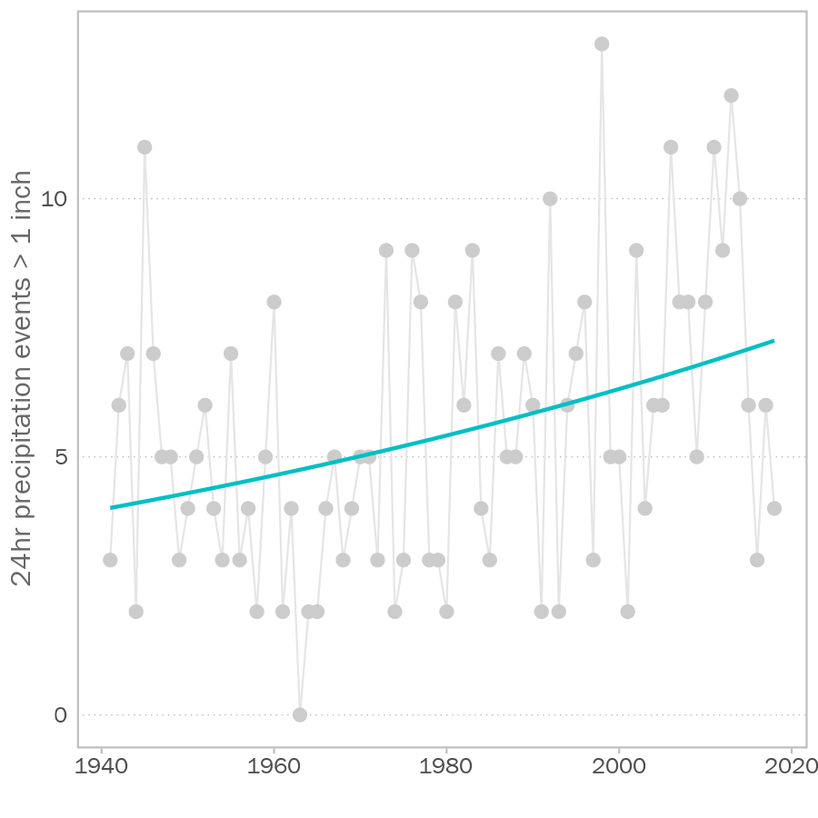
Stream flow – Tropical Storm Irene
CLIMATE CHANGE
Precipitation trends (Burlington Airport)
PRECIPITATION
HYDROLOGY
MACROINVERTEBRATES
Analysis by Phillip Jones, (VTDEC)
Notes:
VTDEC modeling shows statistically significant trends of
Greater frequency of heavy precipitation events
Also seen in NH data

Slide 12
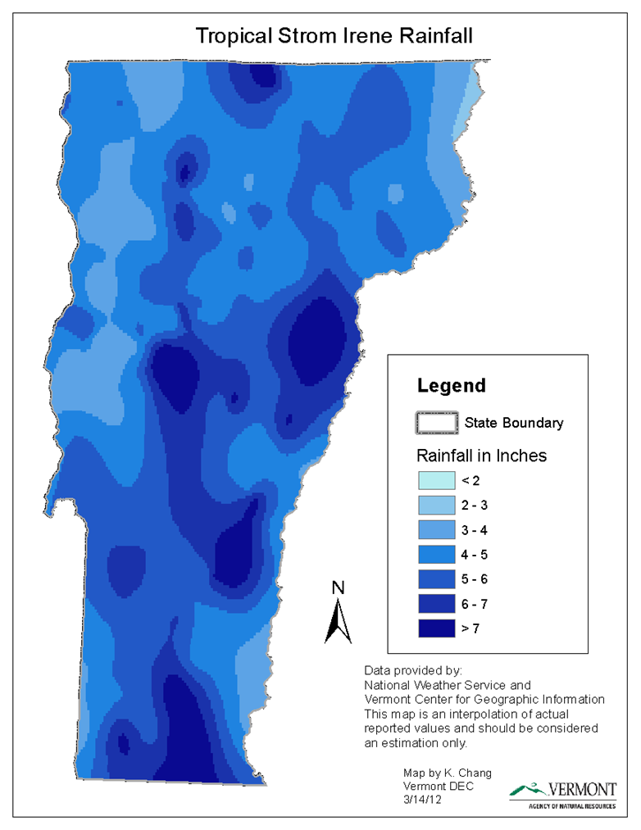
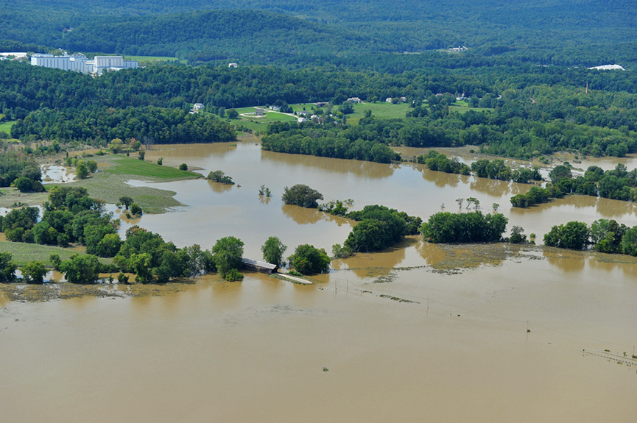
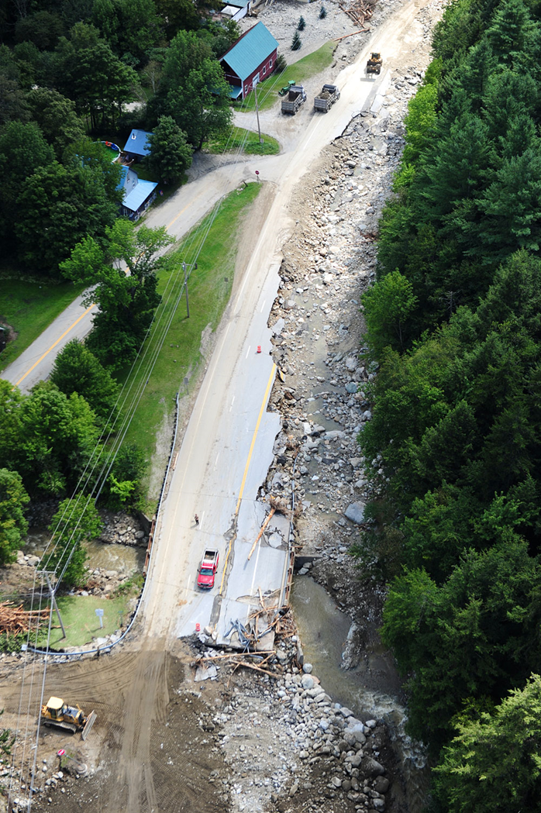
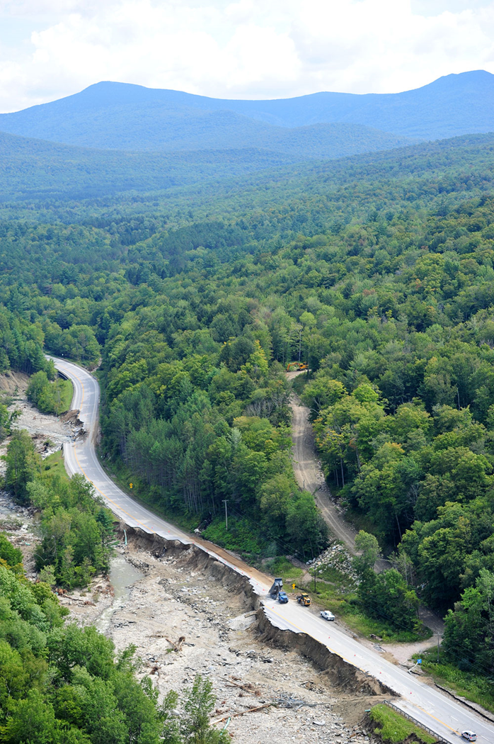
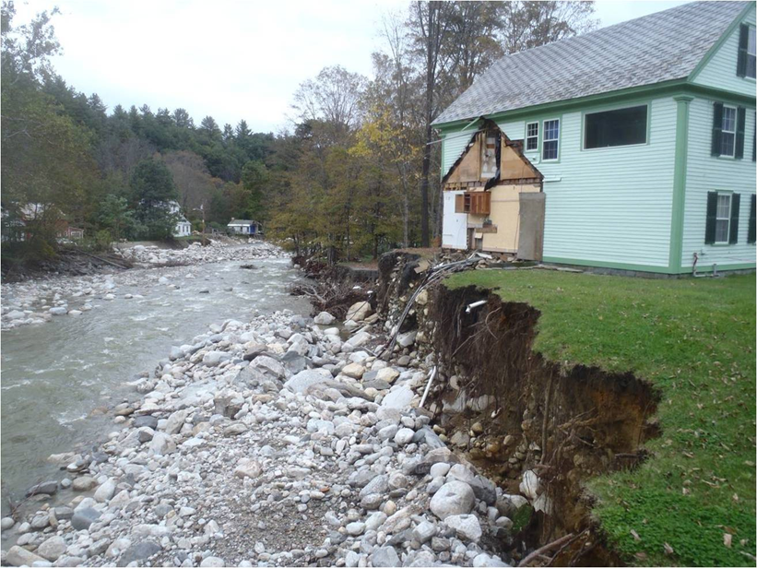
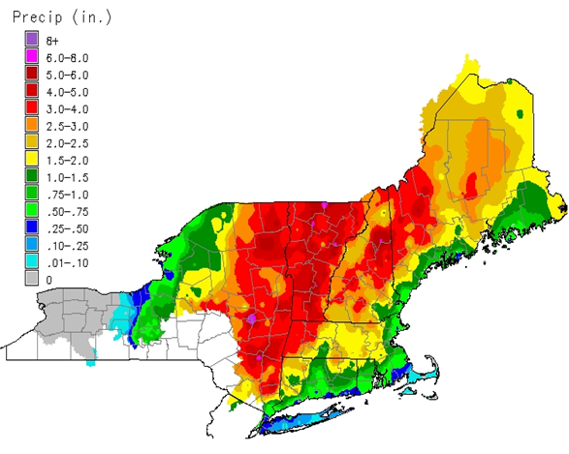
Stream flow – Tropical Storm Irene
24 Hour Rainfall Total August 28-29 (NOAA)
Notes:
Example of a heavy precipitation event everyone remembers is TS Irene
Over 7” total rainfall in many areas of the state;
Widespread flooding, loss of infrastructure and property
Predominately affected areas with steep slopes along Green Mts and Southern VT
Most of our SMALL and MEDIUM sized sentinel streams were located in these areas.

Slide 13
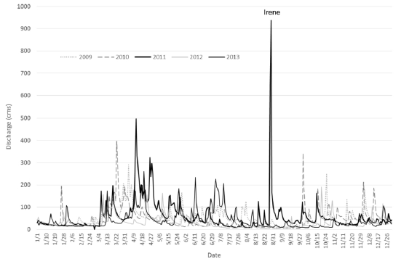
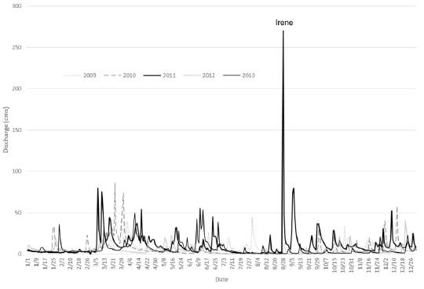
Stream flow – Tropical Storm Irene
White River (USGS 01144000)
North River (USGS 01169000)
Notes:
Heavy precipitation led to extreme flows
Nearly all USGS gages adjacent or downstream of SMALL and MEDIUM sentinel streams had highest flows ever recorded

Slide 14
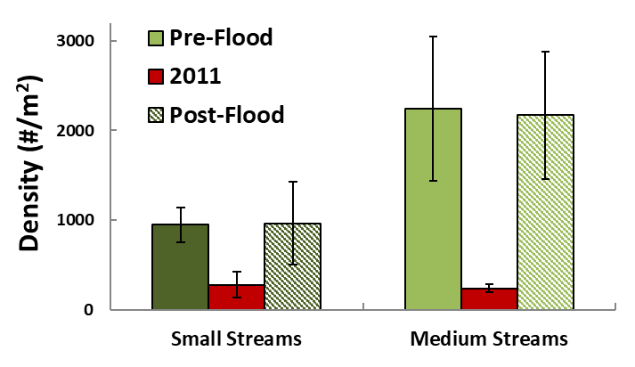
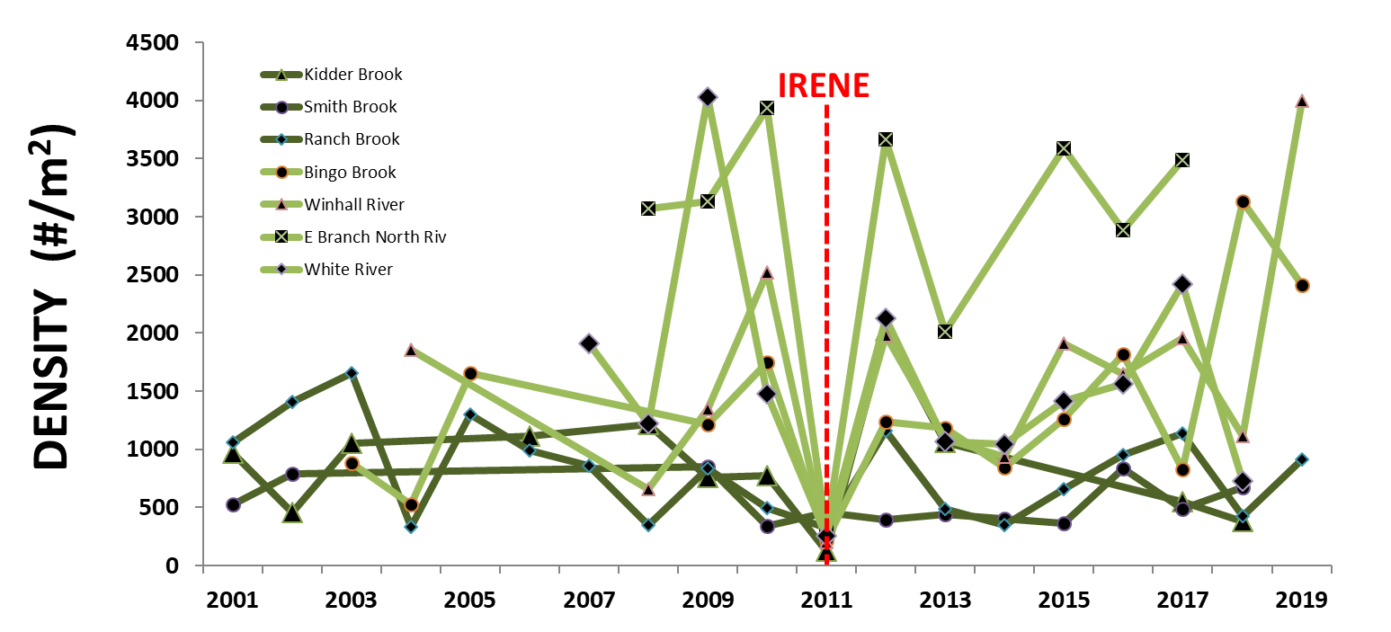
Stream flow – Tropical Storm Irene
Tropical Storm Irene: 8/28 - 8/29
Beginning of index period: 9/1
78% DENSITY decrease in 2011 compared to pre-flood averages
Notes:
Irene also coincided w/ beginning of index period; collecting bugs days to weeks after event.
Looking at how this extreme flow event impacted macroinvertebrates…
BLACK line indicates threshold for metric at/near reference level
Density was decimated; loss of ~80% of macroinvertebrate communities from sites compared to pre-flood numbers
Streams showed resiliency in years after flood; almost immediately back to pre-flood levels

Slide 15
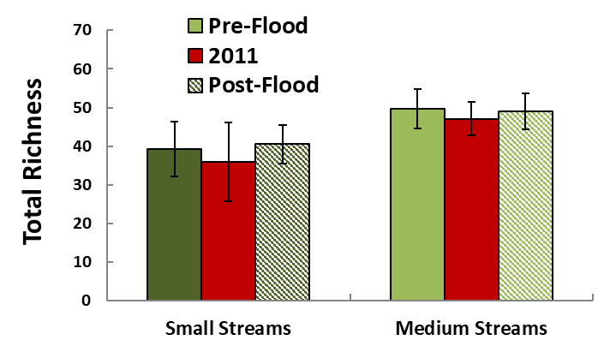
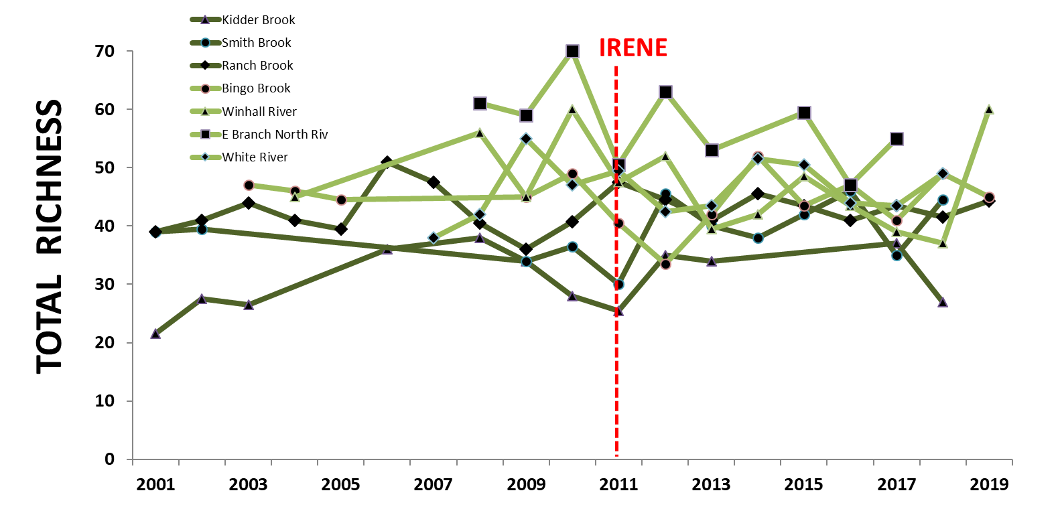
Stream flow – Tropical Storm Irene
7% RICHNESS decrease compared to pre-flood averages
Notes:
Conversely, other metrics were maintained through flood, despite loss of density
Richness no significant decline at most sites
Loss of organisms was not selective for specific types of taxa at reference sites

Slide 16
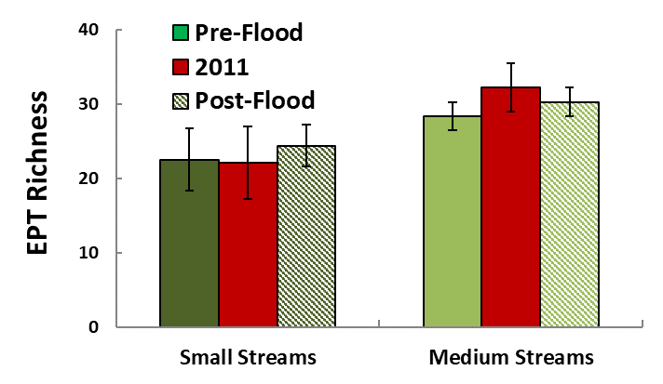
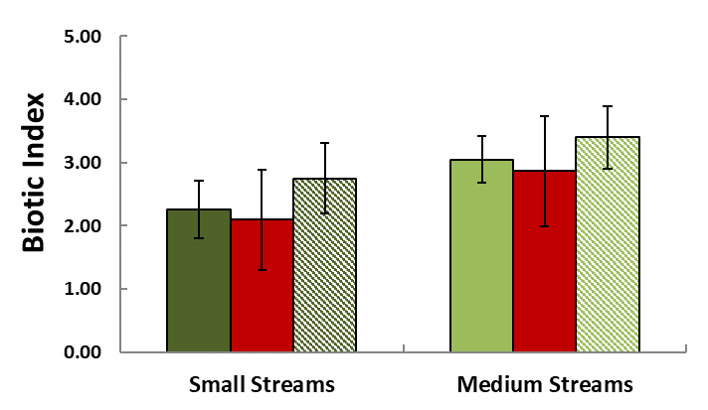
Stream flow – Tropical Storm Irene
6% EPT RICHNESS increase compared to pre-flood averages
7% BIOTIC INDEX decrease compared to pre-flood averages
Notes:
Metrics related to species sensitivity also didn’t show a decline
Both EPT richness and Biotic index were relatively same before and after flood

Slide 17
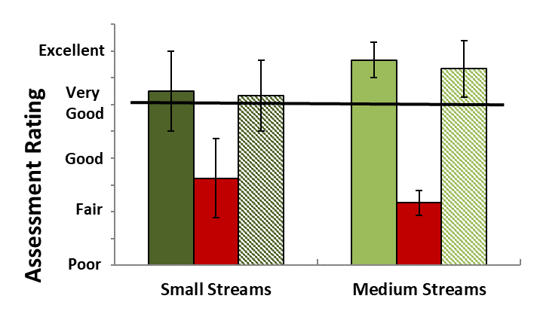
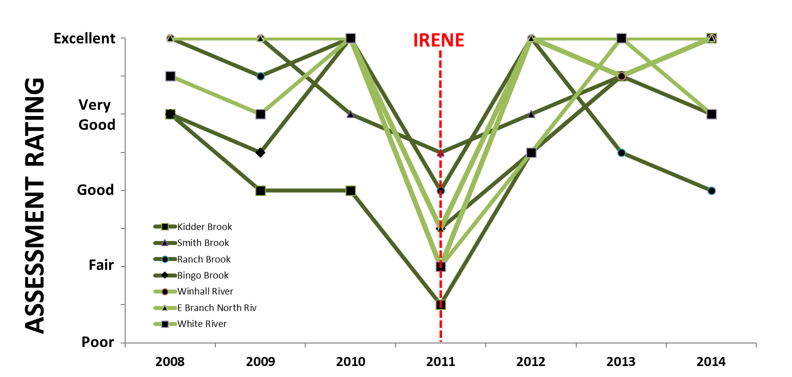
Stream flow – Tropical Storm Irene
7/7 sites failed to meet the minimum threshold for streams at/near reference level in 2011
Notes:
How did this affect site assessments;
Most sites declined and failed in 2011; largely due to density metric
Most were back to reference level by 2012/2013
Analysis shows that streams were resilient to single event, but what happens when extreme flows happen with more frequency?

Slide 18
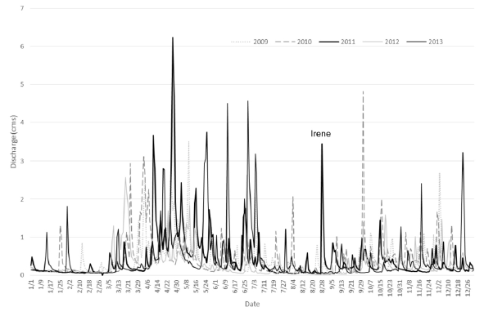
Stream flow – Instability at Ranch Brook
Ranch Brook Flow
Reference streams may be resilient to a single extreme event; what happens when high flows occur with more frequency?
Series of high flow events from 2010-2013
3 of 4 highest peak annual flows in record during this period
Notes:
To address this, can look at data from Ranch Brook
Experienced a series of high flow events from 2010-2014 (of which TS was just 1),
Including 4 of 5 peak annual flows during this time period

Slide 19
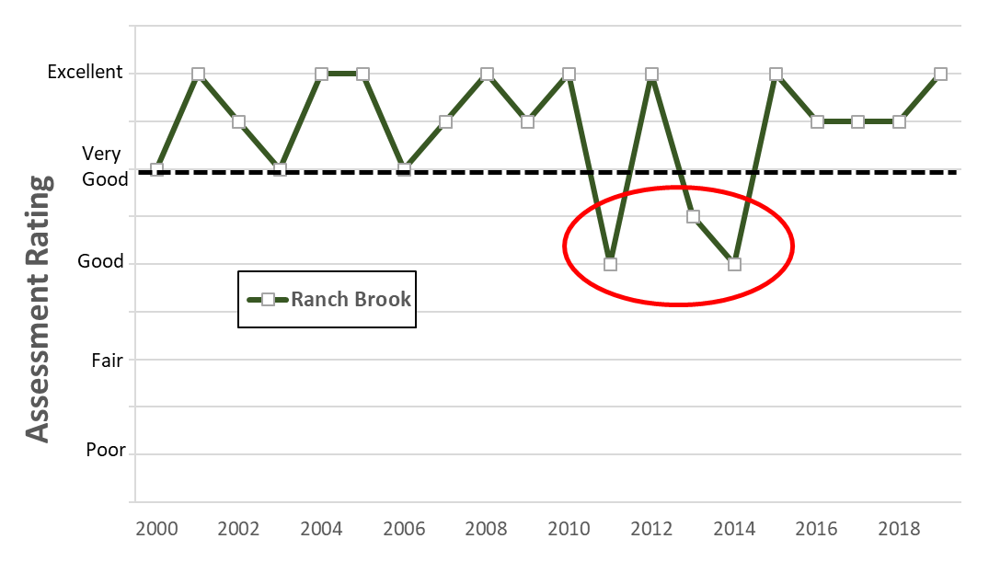
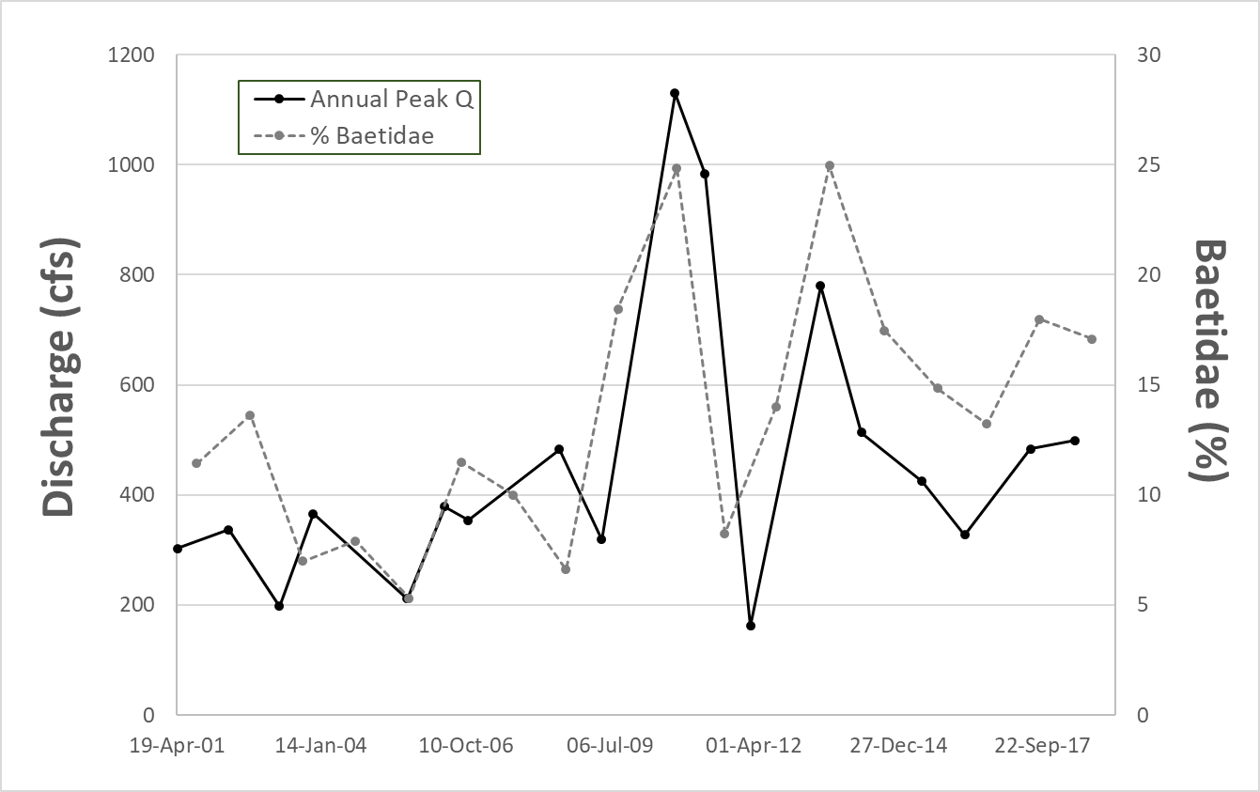
Stream flow – Instability at Ranch Brook
Baetis tricaudatus (mayfly):
Rapid colonizer
Generalist
Disturbance tolerant
Notes:
This seemed to have an extended negative effect on assessments
Corrected after 2014 with more regular flows
Partially due to increases in tolerant taxa
Higher peak annual flows coincide with higher abundances of B.tricaudatus
Rapid colonizer on disturbed substrate, generalist/tolerant

Slide 20
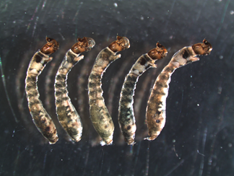
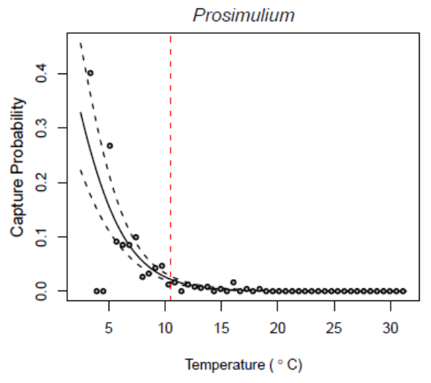
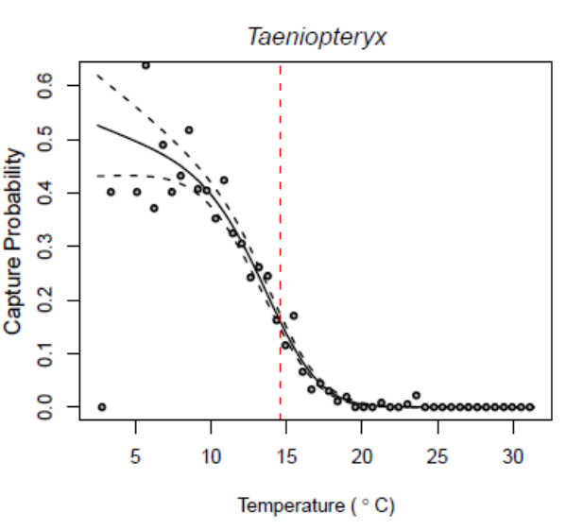
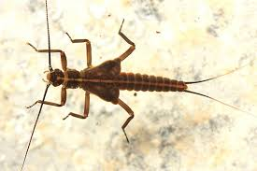
Water temperature – 2019 Seasonal Study
How will temperature affect macroinvertebrates?
Local extinction of cold-water taxa
Changes in regional distribution dependent on thermal tolerance
Notes:
Abruptly switch gear to talk about water temperature
Increasing water temperature can affect insect communities in two ways
Loss of cold-water obligate taxa as streams warm
Either local extinction of taxa, or changes in distribution to more suitable streams
This would certainly have a negative affect on assessments

Slide 21
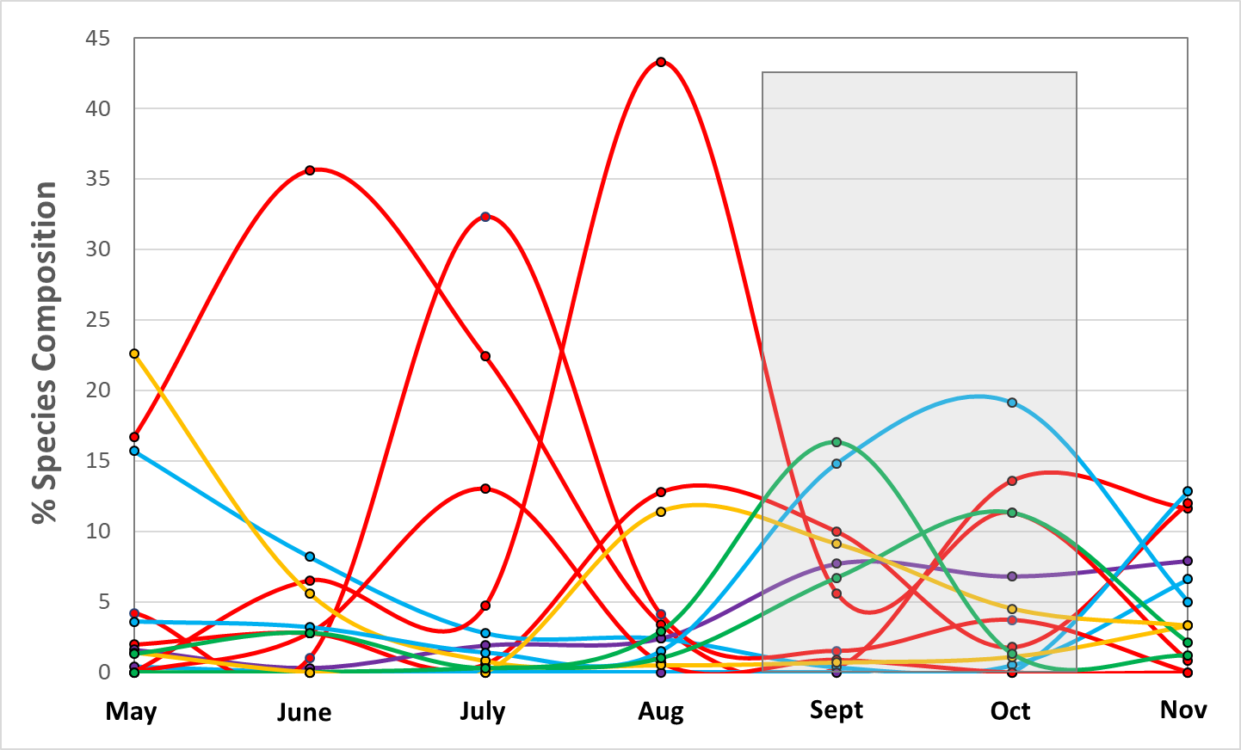
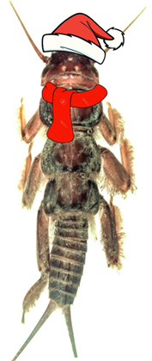
Water temperature – 2019 Seasonal Study
How will temperature affect macroinvertebrates?
Phenological response; species have life stages triggered by temperature
Will increasing temperatures cause summer taxa to persist further into index period? (e.g. Glazaczow et al. 2016)
Will this affect assessment ratings?
Notes:
Phenological response – species have life stages that are triggered by temperature
Increased temperatures could cause summer taxa to persist longer into index period;
During summer 2019, went monthly to 5 sentinel streams
Plot shows all taxa @ Ranch Brook that were present at >5% during at least one month

Slide 22
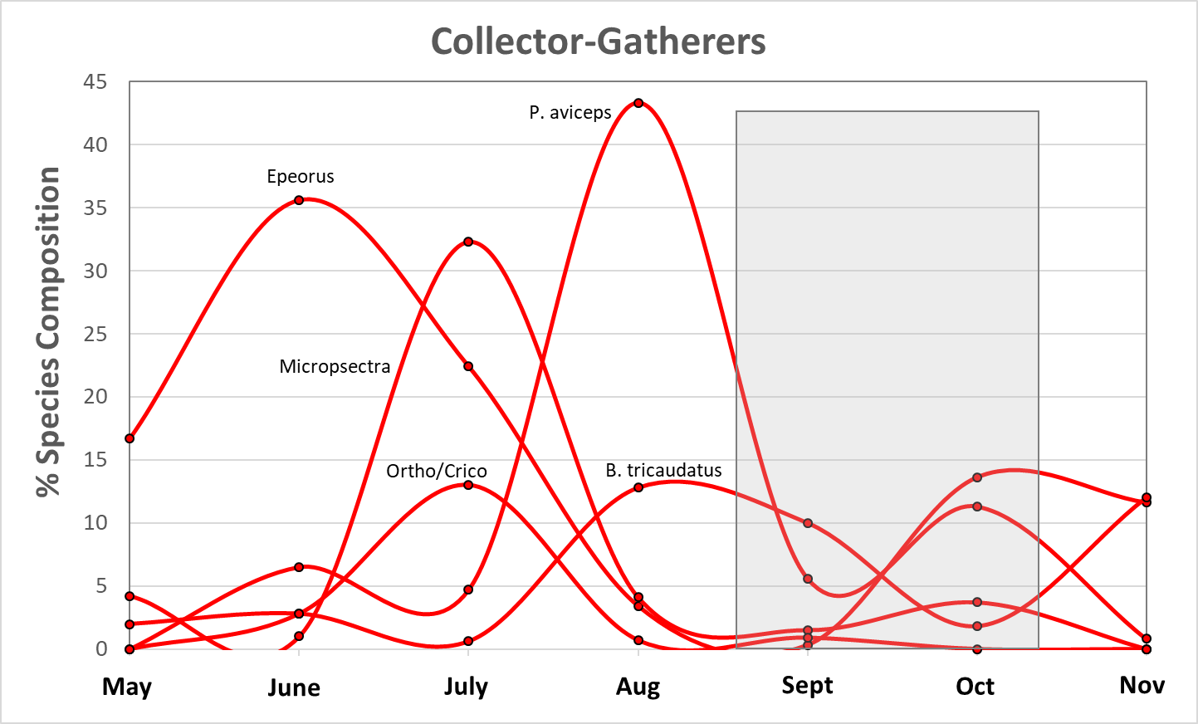
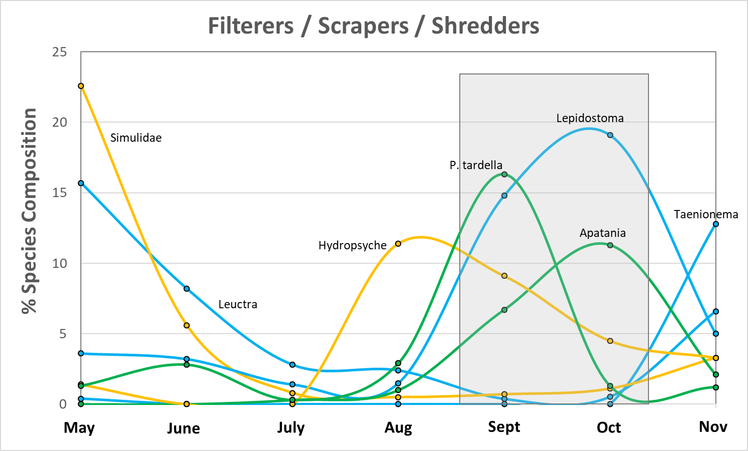
Water temperature – 2019 Seasonal Study
Notes:
Colors represent the major feeding strategy groups for stream insects
Separating feeding group gives a clearer picture of seasonal changes
During summer there is a dominance of generalist collector-gatherers), particularly midge larvae
Fewer “specialist” feeders like detritus shredders and algae scrapers, which are more abundant in colder months
Many of these are the taxa more sensitive to pollution and disturbance

Slide 23
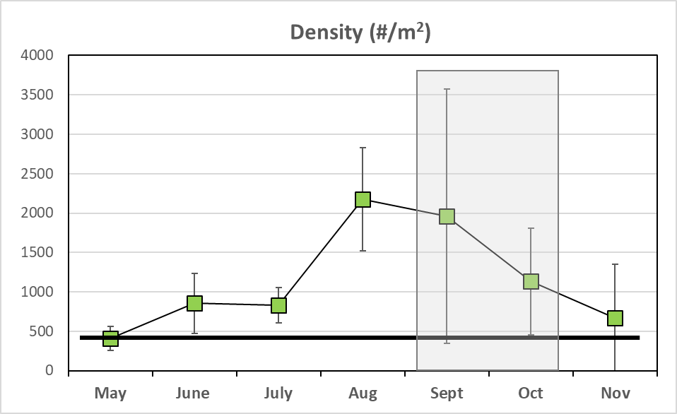
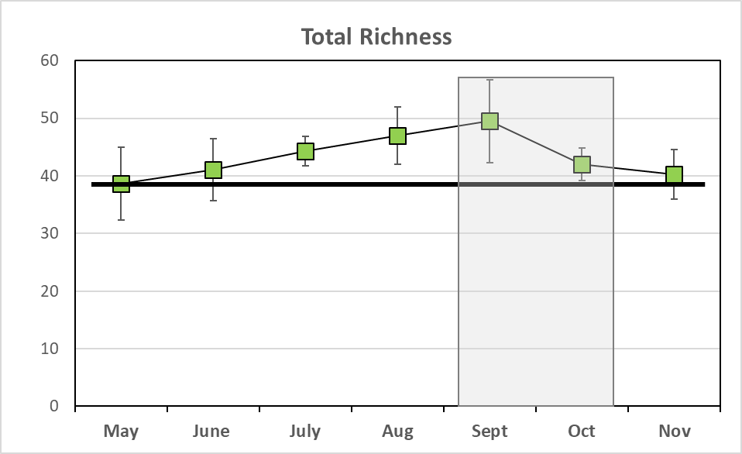
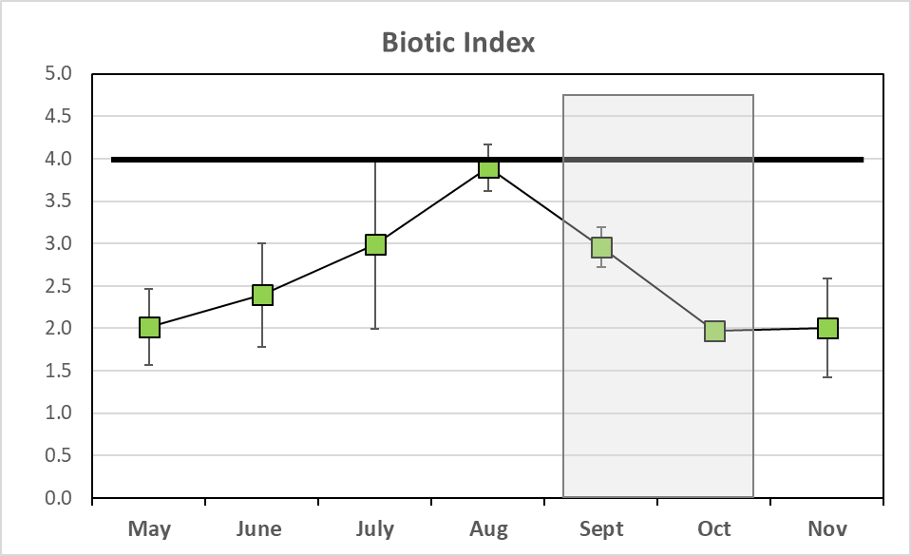
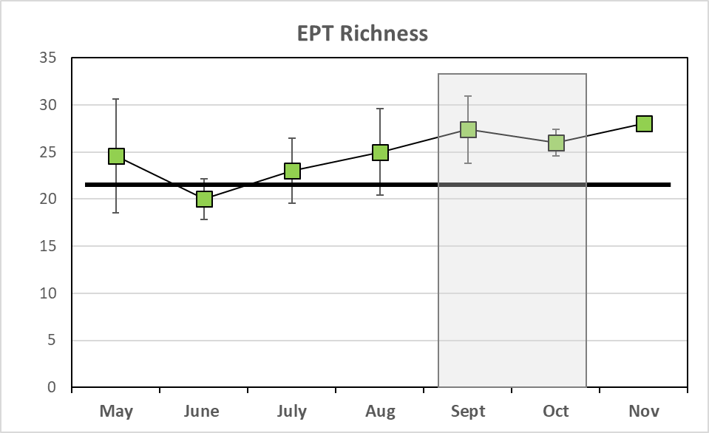
Water temperature – 2019 Seasonal Study
Notes:
How did this affect metrics?
Explain plots again; grey box is index period, black line is criteria for stream at or near reference level
Density low during colder months, peaks during summer
Total and EPT Richness show slight increase through summer,
Total Richness dips as weather gets cold but EPT doesn’t; could be due to loss of some more tolerant generalist taxa
Biotic index highest during warmest time of year, when community is dominated by more tolerant taxa

Slide 24
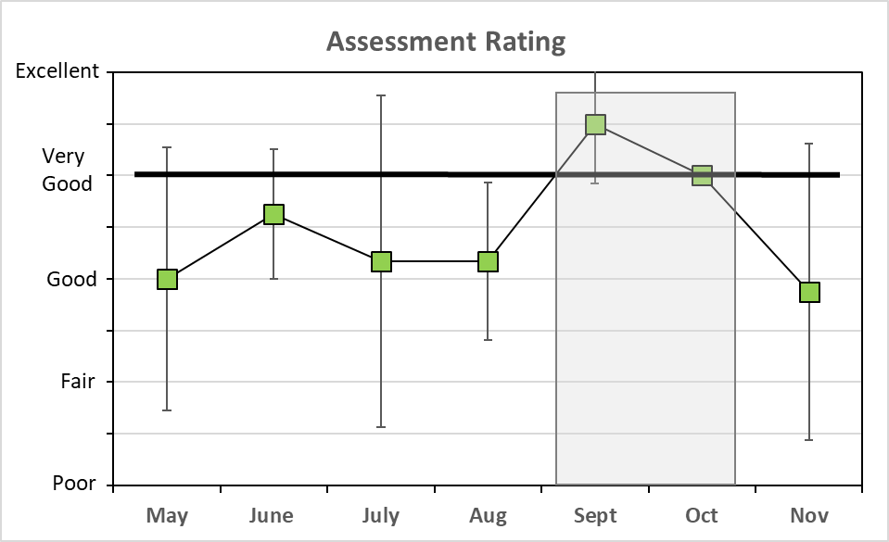
Water temperature – 2019 Seasonal Study
How will temperature affect macroinvertebrates?
Phenological response; species have life stages triggered by temperature
Will Summer taxa persist further into index period?
Will this affect assessments?
Notes:
How did this affect metrics?
Nearly all assessments in index period were at/above Very Good, those outside index period are most often below
Not surprising, since those thresholds were created from fall data
but shows that ability to assess sites could be affected if increased temps cause tolerant summer species begin to persist later in the year (add arrows to plots)

Slide 25




Cotton Brook Landslide
Water Chemistry/Instream Habitat
Notes:
Shift gears one last time to talk about the landslide that occurred at Cotton Br this summer
Happened to coincide with seasonal study, and
Geographically adjacent and similar to the sentinel stream at Ranch Brook
Landslide wasn’t specifically caused by climate change, however
This landslide was likely driven by heavy spring precipitation
Landslides in general are predicted to occur more frequently with climate change
Gives us a glimpse of water quality problems that may occur w/ these types of catastrophic events
Quick overview of landslide
At the end of May, 12 acres fell off the side off steep valley wall
Initial loss of 250,000 cubic meters; 100k into brook and delta

Slide 26





Cotton Brook Landslide
RANCH BROOK
UPPER COTTON
LOWER COTTON
Notes:
Opportunity to compare chemistry and biology below the landslide with the stream above the landslide, and our reference site
Photos of Ranch Brook and Cotton Brook above landslide show similarity between the two streams
Contrast with Cotton Brook below landslide
Turbidity and massive fine sediment deposits

Slide 27




Cotton Brook Landslide
Notes:
Video from almost two months after landslide showing turbidity

Slide 28


Cotton Brook Landslide
Impacts of total suspended solids on Invertebrates:
Scour
Burial
Abrasion
Respiration efficiency
Feeding efficiency
Habitat degradation
Landslide Date
Notes:
A look at turbidity and Total Suspended Solid #’s
Comparing values at Ranch, Upper Cotton, and WQS gives a measure of the prolonged severity of disturbance
Highest in August w/ gradual decline
Increase in November (11 days after Halloween storm redistributed sediment and debris)
Plot at the bottom shows the sampling dates and flow conditions at nearby Ranch Brook

Slide 29

Cotton Brook Landslide
Notes:
Phosphorus follows same downward trend, up again in Nov
Again, comparison to Ranch and Upper Cotton Brook show how dramatic the numbers are
Note that this is TOTAL, most of phosphorus is bound to clay particles and not bioavailable; DP was just over 1% of total
Iron follows same trend; dissolved iron ~7% of total

Slide 30



Cotton Brook Landslide
Assessment Ratings
 | Sept | Oct
Ranch Brook | Excellent | Very Good
Upper Cotton | Good | Good
Lower Cotton | Poor | Poor
Notes:
How did impacts on water quality affect the macroinvertebrate community?
Density at reference site peaked in the summer and came down in fall
Lower Cotton was 35-60x before being an increase in Nov
Richness at reference was high and steady throughout period
Upper Cotton similar, decreased during index period
Lower Cotton~3-5x less
Biotic index at reference site increased during the summer and down in fall
Values at Lower Cotton show the few bugs that were there were generally very tolerant, though value was very low in Nov
Subsequently, assessment ratings were at/near ref at Ranch Brook; lower at Upper Cotton due to dip in Richness, and as low as possible at Lower Cotton
So why the apparent slight improvement in Nov?
Halloween storm was an extreme event in this area; likely washed many bugs down from upstream; many of the Nov bugs found were transient
Data shows little true recovery over 1st 6 months, but plan to track recovery over subsequent years

Slide 31

Putting it all together
Vermont’s sentinel stream monitoring measures FLOW, TEMPERATURE and MACROINVERTEBRATE communities, as well as other parameters, to understand the impacts of climate change
Full understanding of interactions may require decades of data, but early analyses are informative:
  Catastrophic events like Tropical Storm Irene and the Cotton Brook landslide show that communities can be rapidly decimated
  Reference sites may be resilient to single extreme flow events, but more frequent events may destabilize communities
  Summer temperatures favor the increased production of tolerant species; future temp increases could allow these taxa to proliferate into the fall index period
  These impacts may affect the State’s ability to assess stream health using current thresholds, and may require an eventual recalibration of current procedures
Acknowledgements
Vermont DEC staff (Jim Deshler, Michelle Graziosi, Heather Pembrook, Steve Fiske, Jim Kellogg, Blaine Hastings, Phillip Jones, Marjorie Gale), Jen Stamp (Tetra Tech Inc), US EPA Region 1 staff

